Slide 1
Common statistics concepts in public health research
Dr. Gary Chan
Centre for Youth Substance Abuse Research

Slide 2
Public health research and statistics
Aims
Interpret basic statistics commonly reported in public health research
E.g. Odd ratios, risk ratio, 95% confidence intervals, p-value, etc.
Be a critical consumer of public health research
This workshop will not teach you data analysis and statistical modelling

Slide 3
Public health research and statistics
Four case studies
Lung caner – What contributes to a surge of lung cancer after WW1?
Hospitalization rates in coal seam gas area – Are residents sicker in area where the coal seam gas industry is present?
Air pollution and heart failure – Does air pollution contribute to heart failure?
Mediterranean diet and BMI – Can Mediterranean diet be effective in weight management?

Slide 4
Public health research and statistics
Two key goals of public health research
Understanding the distribution of a disease
Geographical distribution, distribution by age, sex, social class, etc.
Is certain disease more common in males, in low SES groups, in Black Americans?
Identifying determinants of disease
Smoking for lung cancer, sugar drink for diabetes, etc.

Slide 5
Public health research and statistics
Two key goals of public health research
Understanding the distribution of a disease
Geographical distribution, distribution by age, sex, social class, etc.
Is certain disease more common in males, in low SES groups, in Black Americans?
Identifying determinants of disease
Smoking for lung cancer, sugar drink for diabetes, etc.

Slide 6
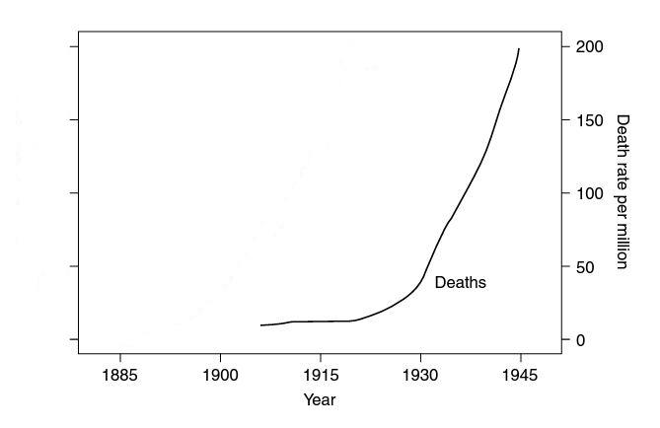
Case study 1: Lung cancer
Surge of lung cancer cases after World War 1. (Figure adapted from Woodward, 2014)

Slide 7
Case study 1: Lung cancer
Possible explanation
Increased pollution
car ownership increased exponentially (many cars used diesel fuel)
thriving manufacturing industry
Expanding agricultural production (more burnings in farm)
Medical advances
increase life expectancy
reduced mortality from infectious diseases
improved diagnostic technologies (cancer cases in the early 1900 were misdiagnosed as tuberculosis, pneumonia, etc)

Slide 8
Case study 1: Lung cancer
And… maybe cigarette smoking?
Sir Richard Doll and Sir Austin Bradford Hill’s study on smoking
Recruited 709 lung cancer patients in 20 hospital in London
Recruited another 709 noncancer patients of the same sex and 5-year age group from the same hospital at about the same time (Why?)
This is an example of case-control study.
While there was a surge in lung cancer cases, it was still a relatively rare disease.
Case-control study ensures that there is a sufficient sample size (enough disease cases).
Impossible to perfectly match the case with control.

Slide 9
Case study 1: Lung cancer
Advantages of case-control studies
Quick and cheap
Many risk factors can be studied simultaneously
Well suited for rare disease
Require a relatively small size

Slide 10
Case study 1: Lung cancer
Major disadvantages of case-control studies
Can investigate only one disease
Cannot generally establish time sequence of the event (with some exceptions e.g. genetic risk and cancer)
High risk of bias due to sampling of the control group

Slide 11
Case study 1: Lung cancer
Findings
 | Cases | Controls
Non-smokers | 21 (3.0%) | 59 (8.3%)
Smokers | 688 (97.0%) | 650 (91.7%)
Total | 709 (100%) | 709 (100%)

Slide 12
Case study 1: Lung cancer
Evaluating and quantifying the association – Odds ratio
Since this is a case-control study, risk ratio (relative risk) cannot be calculated.
Odds of developing lung cancer for smokers: D_{E} /ND_{E}
Odds of developing lung cancer for non-smokers: D_{NE}/ND_{NE}
D for Disease; ND for No Disease; subscript E for Exposed; subscript NE for Not Exposed
Ratio between these two odds is the ODDS RATIO:
 | Cases | Controls
Non-smokers | D_{NE} | ND_{NE}
Smokers | D_{E} | ND_{E}

Slide 13
Case study 1: Lung cancer
Calculating the odds ratio
OR = = 2.974
What does this number mean?
 | Cases | Controls
Non-smokers | 21 (3.0%) | 59 (8.3%)
Smokers | 688 (97.0%) | 650 (91.7%)
Total | 709 (100%) | 709 (100%)

Slide 14
Case study 1: Lung cancer
Calculating the odds ratio (based on hypothetical data)
OR = ?
 | Cases | Controls
Non-smokers | 41 (5.0%) | 50 (6.0%)
Smokers | 779 (95.0%) | 770 (94.0%)
Total | 820 (100%) | 820 (100%)

Slide 15
Case study 1: Lung cancer
Calculating the odds ratio (based on hypothetical data)
OR = ?
 | Cases | Controls
Non-smokers | 123 (15.0%) | 82 (10.0%)
Smokers | 697 (85.0%) | 738 (90.0%)
Total | 820 (100%) | 820 (100%)

Slide 16
Case study 1: Lung cancer
Calculating the odds ratio (based on hypothetical data)
OR = ?
 | Cases | Controls
Non-smokers | 82 (10.0%) | 74 (9.0%)
Smokers | 738 (90.0%) | 746 (91.0%)
Total | 820 (100%) | 820 (100%)

Slide 17
Case study 1: Lung cancer
Interpretation of odds ratio
> 1 | Exposure increases the odds of developing the disease
= 1 | Exposure does not change the odds of developing the disease
< 1 | Exposure reduces the odds of developing the disease

Slide 18
Case study 1: Lung cancer
How confidence are we about the odds ratio estimate?
Calculating the confidence interval (CI)
A range of values which we are fairly confident will contain the “true” odds ratio in the population
95% CI is usually specified.
We are 95% confident that the 95% confidence interval will contain the “true” odds ratio.
Imagining the study is repeated over and over again.
Coin tossing experiment

Slide 19
Case study 1: Lung cancer
How do we decide if a coin is a fair coin? (i.e. probability of getting a head is 0.5; 50% chance)
Toss the coin 100 times
Count the number of heads
E.g. If we got 54 heads out of 100, we would estimate that the probability of getting a head is 0.54, with a 95% confidence interval of (0.44 – 0.64)
Repeat this experiment many times (e.g. 1000 times).

Slide 20
Case study 1: Lung cancer
Trial # | Estimated probability | 95% Confidence interval
1 | 0.53 | (0.43, 0.63)
2 | 0.50 | (0.40, 0.60)
3 | 0.37 | (0.28, 0.46)
4 | 0.55 | (0.45, 0.65)
5 | 0.59 | (0.49, 0.69)
6 | 0.45 | (0.35, 0.55)
7 | 0.50 | (0.40, 0.60)
8 | 0.56 | (0.46, 0.66)
9 | 0.52 | (0.42, 0.62)
10 | 0.50 | (0.40, 0.60)
11 | 0.44 | (0.34, 0.54)
12 | 0.59 | (0.49, 0.69)
95% of confidence intervals will contain the true estimate.
It is possible that a small number (5%) of the 95% confidence intervals do not contain the true estimate.

Slide 21
Case study 1: Lung cancer
What is the 95% confidence interval in Doll and Hill’s data?
The confidence interval of OR can only be calculated in “log scale”.
1. Calculating the log-odds:
log(OR) = log(2.974)=1.090
2. Calculating the standard error (SE; a measure of uncertainty in the estimate) of log-odds:
SE(OR) =
=
= 0.260
 | Cases | Controls
Non-smokers | D_{NE} (21) | ND_{NE} (59)
Smokers | D_{E} (688) | ND_{E} (650)

Slide 22
Case study 1: Lung cancer
What is the 95% confidence interval in Doll and Hill’s data?
3. Calculating the upper and lower bound of the confidence interval in log scale
Upper bound: log(OR) + 1.96SE = 1.090 + 1.96*0.260
Lower bound: log(OR) – 1.96SE = 1.090 – 1.96*0.260
95% CI in log scale: (0.580, 1.600)
4. Converting the CI into odds ratio
Exponentiating 0.580 and 1.600
Lower bound: Exp(0.580) = 1.79
Upper bound: Exp(1.60) = 4.95
95% CI: (1.79, 4.95)
We are 95% confident that the true odds ratio in the population in between (1.79 and 4.95)

Slide 23
Case study 1: Lung cancer
Limitations in this study
Causality can never be inferred from cross-sectional study.
Control group may not be sufficiently compatible with cases (the comparison is not “fair”)
E.g. cancer patients were from a wider catchment area; controls were mostly city dwellers.

Slide 24
Case study 1: Lung cancer
Key points

Slide 25
Case study 1: Lung cancer
Cohort study
Doll and Hill recruited a cohort of male doctors in the UK in 1951
Over 30,000 doctors participated, and they were followed for 50 years.
Conclusion: Smoking did predict developing lung caner later in life (Doll et al, 2004).
Still, causality cannot be inferred from this study alone – There may be other confounding factors (e.g. genetic risk that predispose an individual to smoking and developing lung cancer)

Slide 26
Case study 1: Lung cancer
Advantages of cohort study
Give direct information on the sequence of events
Necessary for demonstrating causality (but not sufficient)
Many diseases can be studied simultaneously (e.g. heart problem, other cancers, etc.)
Major disadvantages of cohort study
Very expensive and time consuming
Generally not suitable for disease with a long latency (e.g. caner; Doll et al continuously collected data for 50 years!)
Generally not suitable for rare disease (e.g. cancer; unless you follow a large sample over a long period of time like Doll et al)

Slide 27
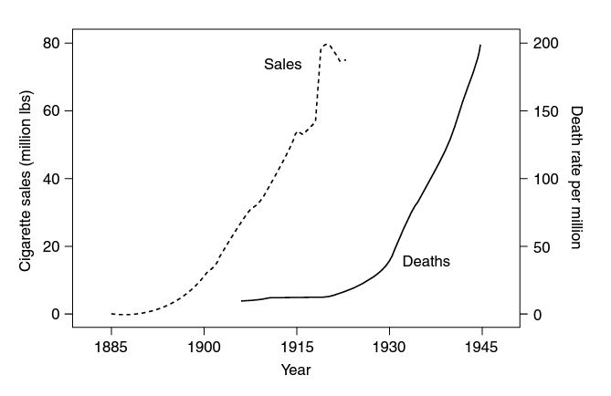
Case study 1: Lung cancer
Evidence from other studies, E.g. Peace (1985), increases the plausibility of a causal interpretation.

Slide 28
Case study 1: Lung cancer
Hypothetical data (generated based on Doll and Hill’s study) of developing lung cancer over a 50-year period..
Quantifying this association using risk ratio (relative risk)
 | Lung cancer | No lung cancer | Total
Smokers | 2179 | 15321 | 17500
Lifelong non-smokers | 115 | 13385 | 13500
Total | 2294 | 28706 | 31000

Slide 29
Case study 1: Lung cancer
Risk: Probability (chance) of developing a disease
Risk of developing lung cancer among smokers: D_{E}/(D_{E}+ND_{E})
Risk of developing lung cancer among lifelong non-smokers: D_{NE}/(D_{NE}+ND_{NE})
Risk ratio of developing lung cancer:
 | Lung cancer | No lung cancer | Total
Smokers | D_{E} | ND_{E} | D_{E} + ND_{E}
Lifelong non-smokers | D_{NE} | ND_{NE} | D_{NE}+ND_{NE}
Total | D_{E} + D_{NE} | ND_{E} + ND_{NE}

Slide 30
Case study 1: Lung cancer
Calculating the risk ratio
Risk of lung cancer among smokers: 2179/17500 = 0.1245 (12.45% chance)
Risk of lung cancer among lifelong non-smokers: 115/13500 = 0.0085 (0.85% chance)
Risk ratio of developing lung cancer: 0.1245/0.0085 = 14.6
 | Lung cancer | No lung cancer | Total
Smokers | 2179 | 15321 | 17500
Lifelong non-smokers | 115 | 13385 | 13500
Total | 2294 | 28706 | 31000

Slide 31
Case study 1: Lung cancer
Interpretation of risk ratio
Compared to lifelong non-smokers, smokers have 14 times higher risk of developing lung cancer over a period of 50 years.
> 1 | Exposure increases the risk of developing the disease
= 1 | Exposure has no impact on the risk of developing the disease
< 1 | Exposure reduces the risk of developing the disease

Slide 32
Case study 1: Lung cancer
Odds ratio or risk ratio?
Risk and risk ratio are more natural way to describe the impact of exposure on disease outcome
Risk is the probability (chance) of developing a disease
At face value, it is more difficult to interpret “odds”.
Odds ratio can be calculated using data from longitudinal studies , case-control studies or cross-sectional study using random sample
Risk ratio cannot be calculated using data from case-control study
Odds ratio can be obtained easily from logistic regression (a common statistical modelling technique)
Odds ratio is very close to risk ratio, when the disease is not common (< 10% in the population).

Slide 33
Case study 1: Lung cancer
Other way to quantify the association between exposure and disease outcome
Attributable fraction for the population (population attributable risk)
Proportion of the disease cases in the population that can be attributable to the exposure
Proportion of the disease cases in the population that can be eliminated if the everyone in the population was not exposed (i.e. eliminating the exposure from the population).
Attributable fraction among the exposed (attributable risk among the exposed)
Proportion of the disease cases in the exposure group that can be attributable to the exposure
Proportion of the disease cases in the exposure group that can be eliminated if everyone in the exposure group was not exposed (i.e. eliminating the exposure from the exposure group).

Slide 34
Case study 1: Lung cancer
Adjusted odds ratio
The odds ratio we computed above is generally referred to “crude odds ratio” or “unadjusted odds ratio”. They will be an unbiased estimates of the true odds ratio in the population in well-designed study in which the sample is a simple random sample.
Adjusted odds ratio will be needed if the sample is not a simple random sample, and it can be estimated using logistic regression.

Slide 35
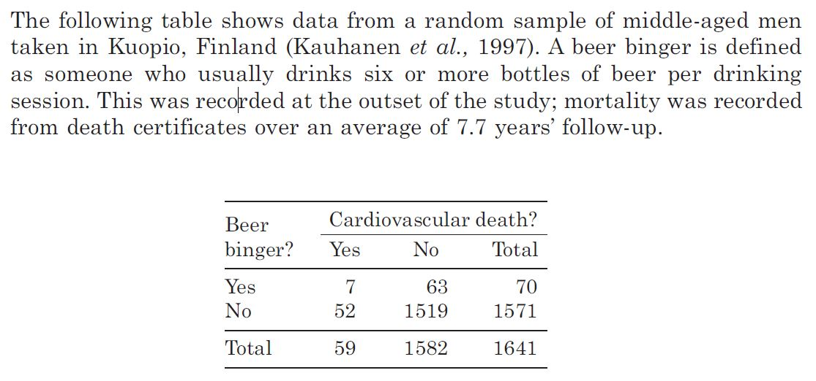
Case study 1: Lung cancer
Exercise
Calculate the odds ratio and risk ratio of cardiovascular death

Slide 36
Case study 1: Lung cancer
Key points

Slide 37
Public health research and statistics
Two key goals of public health research
Understanding the distribution of a disease
Geographical distribution, distribution by age, sex, social class, etc.
Identifying determinants of disease
Smoking for lung cancer, sugar drink for diabetes, etc.

Slide 38
Case study 2: Hospitalization rates
Werner et al (2016) examined trends of hospitalization rates in three geographical area in Queensland: a coal seam area, a coal mining area and a rural area.
The coal seam gas industry has expanding rapidly in the last two decades.
Public has voiced concerns about the potential health impacts related to the coal seam gas industry.

Slide 39
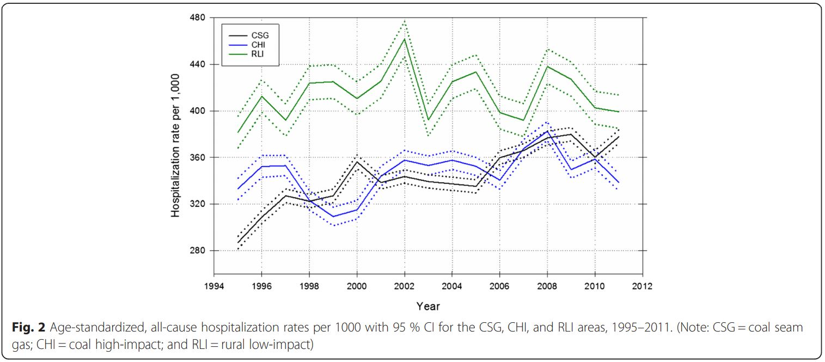
Case study 2: Hospitalization rates

Slide 40
Case study 2: Hospitalization rates
What is an “age-standardized rate”?
Rate, such as number of disease cases or hospitalizations per 1000 or 100,000 population, is an important tool for comparison for data collected at the same time point.
Percentage is a form of rate when the denominator is 100.
Adjustment may be needed for comparison over time.
E.g. If the age structure of the population change over time, adjusting for age is necessary for a “fair comparison”.
Rate that is not adjusted for any factor is usually referred to as a “Crude rate”.
“Age-standardized rate” means that the rate is adjusted for age.

Slide 41
Case study 2: Hospitalization rates
Cancer deaths and population estimates in Canada in 2000 and 2011.
Age group | Characteristic | 2000 | 2011
0 to 39 years | Estimate of population | 17,068,876 | 17,191,850
 | Number of deaths | 1,345 | 1,004
 | Crude rate (per 100,000 population)
40 years and over | Estimate of population | 13,616,854 | 17,150,930
 | Number of deaths | 61,325 | 71,472
 | Crude rate (per 100,00 population)
Total all ages | Estimate of population (Sum of the above 2 age groups)
 | Number of deaths (Sum of the above 2 age groups)
 | Crude rate

Slide 42
Case study 2: Hospitalization rates Crude rate = 1345/17068876 * 100000
Cancer deaths and population estimates in Canada in 2000 and 2011.
Age group | Characteristic | 2000 | 2011
0 to 39 years | Estimate of population | 17,068,876 | 17,191,850
 | Number of deaths | 1,345 | 1,004
 | Crude rate (per 100,000 population) | 7.880
40 years and over | Estimate of population | 13,616,854 | 17,150,930
 | Number of deaths | 61,325 | 71,472
 | Crude rate (per 100,00 population)
Total all ages | Estimate of population (Sum of the above 2 age groups)
 | Number of deaths (Sum of the above 2 age groups)
 | Crude rate

Slide 43
Case study 2: Hospitalization rates
Did the rate increase over time for the age group 0-39?
Did the rate increase over time for the age group 40 or above?
Did the rate increase over time for the whole population?

Slide 44
Case study 2: Hospitalization rates
The rates are counter-intuitive.
Rates decrease for both age group, while the rate increase for the overall population.
How could this happen?
The crude rate accurately represents the incidence of cancer death each year, but it is not a correct indicator for comparison across year.
There is a substantial shift in the age structure of the population
A much higher proportion of the population is now over 40 years old
Older people are more likely to die of cancer.
A shift in the age structure can cause a higher rate of cancer death, even the rate decrease at each individual age group.

Slide 45
Case study 2: Hospitalization rates The crude rate of the older age group in 2000, multiplied by the proportion of the older age group in the reference year (1991)
Solution: Standardized the rate to one of the year (usually the first year of the study), or a year that is important to be used as a reference point (e.g. Year 2000).
For example, we could choose the year 1991 as the reference. In this year, 61.6% of the Canadians were under 40 and 38.4% were 40 or above.
The age-standardized rate in 2000 (with reference to 1991) will be (7.880 * 0.616)+(450.361*0.384) = 174.80 cancer deaths per 100,000 standard population. The crude rate of the younger age group in 2000, multiplied by the proportion of the young age group in the reference year (1991).

Slide 46
Case study 2: Hospitalization rates
What are the other age-standardized rate?

Slide 47
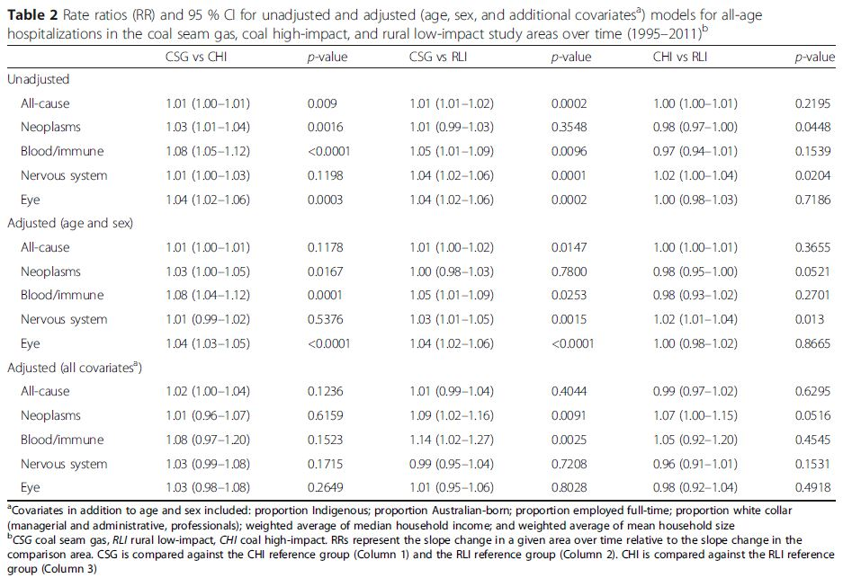
Case study 2: Hospitalization rates

Slide 48
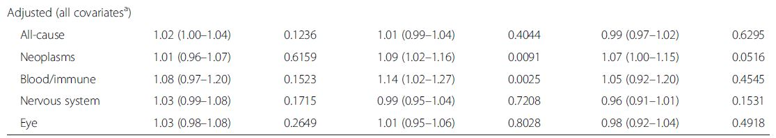
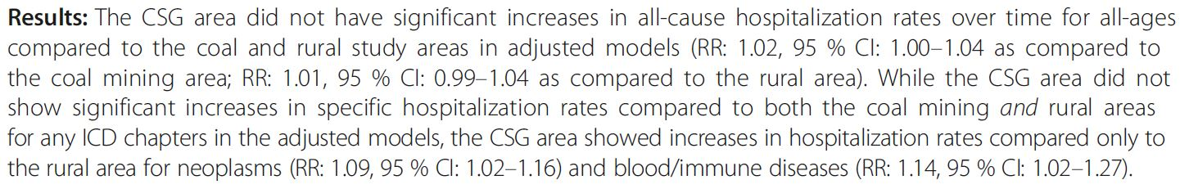
Case study 2: Hospitalization rates

Slide 49
Case study 2: Hospitalization rates
How should we interpret the results?
Do the authors interpret the results correctly?

Slide 50
Case study 2: Hospitalization rates
The authors use an alpha level of 0.05 for statistical significance.
i.e. declaring an association to be statistically significant if the p-value is less than 0.05.
Alpha level is the probability of mistakenly rejecting the null hypothesis when it is true.
What is p-value?
The most mis-interpreted statistics.
P-value is the chance of seeing a difference at least as big as the one currently observed, if in fact, there were no real effect.
Coin tossing

Slide 51
Case study 2: Hospitalization rates
Misuse of the p-value has been widespread.
P-hacking: Researchers select data or analysis strategy to make “non-significant” result “significant”.
Outcome switching: Researchers only reported on outcome variables where they found a “significant” result.
These practices contributed to the reproducibility and replicability crisis.
This workshop will skip many aspect of the p-value discussion
Focus on the concept of “Multiple comparison”.

Slide 52
Case study 2: Hospitalization rates
For a single well-designed un-biased experiment with a hypothesis specified a-priori, the alpha level (level of significance) is usually set at 0.05.
The probability of incorrectly rejecting the null hypothesis when it is true is 0.05
Problem with multiple comparisons
If you make many comparisons, and use 0.05 as alpha level for each comparison, it is nearly certain that you will have the p-value from one of the comparisons less than the 0.05 (purely by chance)
That is, it is very likely that you will make an error in at least one of the comparison.

Slide 53
Case study 2: Hospitalization rates
Coin tossing experiment
Decide if a coin is biased (i.e. testing if the probability of getting a head is larger than 0.50)
Experiment: Toss the coin 100 times and count the number of heads
If the number of heads is close to 50, the coin is unlikely to be biased (i.e. it is a fair coin)
However, if you repeat this experiment many times with a different coin each time, it is likely that in at least one trial, you will have many heads (e.g. 80) purely due to chance.
So you will conclude that one of the coin is “biased”, while in fact it is a fair coin.

Slide 54
Case study 2: Hospitalization rates
A total of 15 comparisons were made.
If an alpha level (level of significance) is set to be 0.05, it is very likely that you will have a result that is “statistically significant”, while in fact the “significant result” is purely due to chance.

Slide 55
Case study 2: Hospitalization rates
An easy and ad hoc solution (but far from perfect way)
Adjust the alpha level (level of significance) for each comparison
0.05/Number of comparisons = 0.05/15 = 0.0033
This is a simple way to defend against making a false positive claim
But this is NOT the best solution (in fact, far from perfect)
Contact a statistician when planning a study
Issue about multiple comparisons needs to be taken into consideration when interpreting results from existing research

Slide 56
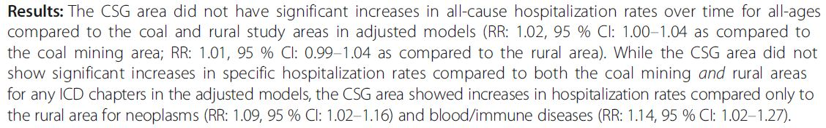
Case study 2: Hospitalization rates
What should the conclusion be after making an adjustment for multiple comparison?

Slide 57
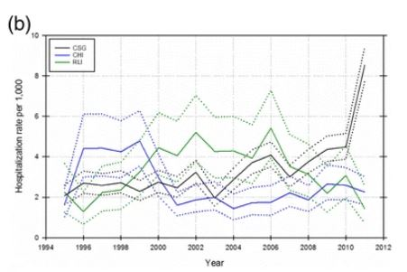
Case study 2: Hospitalization rates
Consider the “Effect size”
Compared to RLI, the rate of hospitalization from blood/immune system disease was 14% higher in coal seam gas (CSG) area than in rural low impact (RLI) area.
The hospitalization rate in in RLI area is ~3 per 1000.
A 14% increase is ~0.5 per 1000. Even this effect is genuine, is it clinically significant?

Slide 58
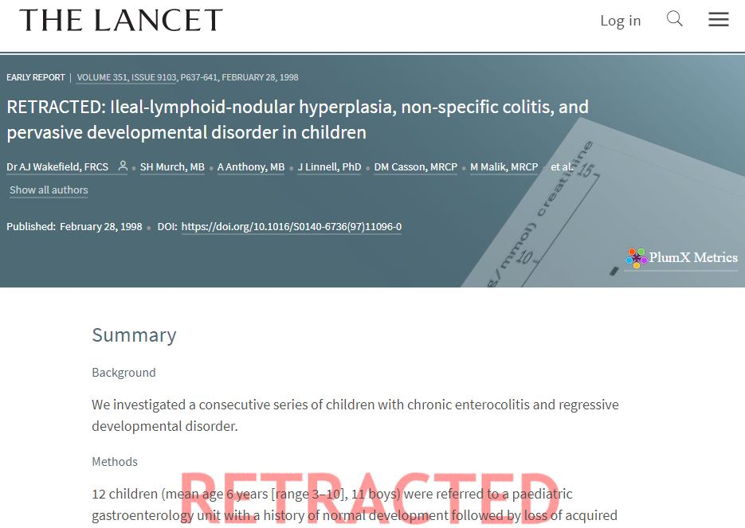
Case study 2: Hospitalization rates
Bottom line
Never draw conclusion based on a single study
You can nearly always find a study that “supports” your pre-existing belief.
E.g. Study on climate change, vaccination, etc.

Slide 59
Case study 2: Hospitalization rates
Bottom line
Meta-analysis and systematic review
Meta-analysis based on RCTs usually provides the strongest evidence
Meta-analysis of longitudinal studies can also provide important information, especially for “exposure” that cannot be randomized (e.g. smoking)
Meta-analysis of cross-sectional studies will need to be interpreted with caution.
Publication bias
Traditionally, research that report a “significant” finding is much more likely to be published.

Slide 60
Case study 2: Hospitalization rates
Key points

Slide 61
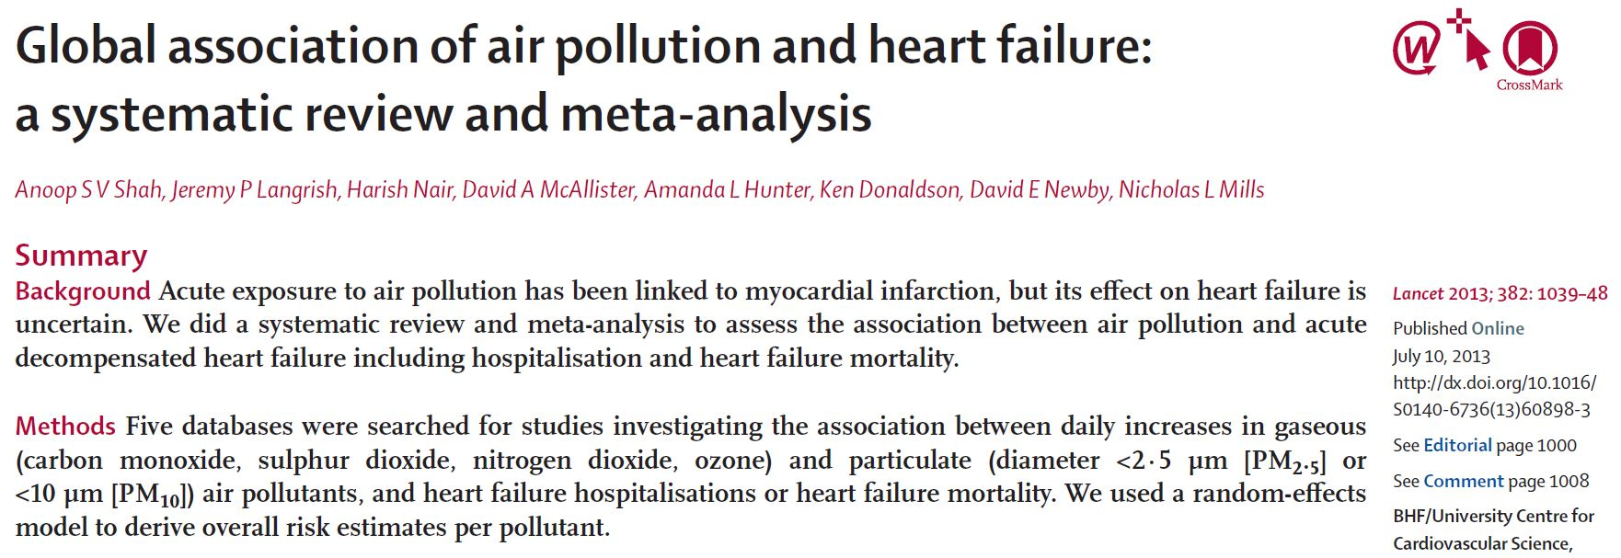
Case study 3: Air pollution and heart disease
Is air pollution associated with heart failure?

Slide 62
Case study 3: Air pollution and heart disease
Science is a cumulative process.
Findings from one single study is not sufficient for making policy decision.
Meta-analysis
Systematic review of existing literature
Identifying related literature with a structured methodology (e.g. Cochrane review procedure).
“A systematic review attempts to identify, appraise, and synthesize all the empirical evidence that meets pre-specified eligibility criteria to answer a given research question.
Is air pollution associated with heart failure?
Aggregating results from multiple studies

Slide 63
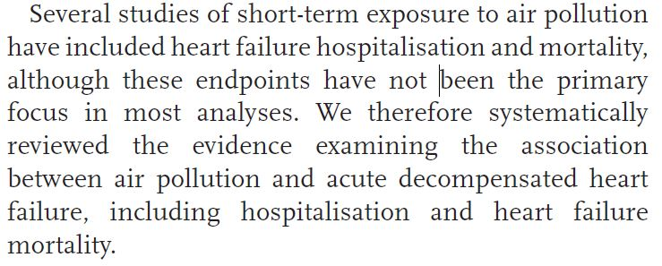
Case study 3: Air pollution and heart disease
Interpreting findings from a systematic review and meta-analysis
What is the research question?

Slide 64
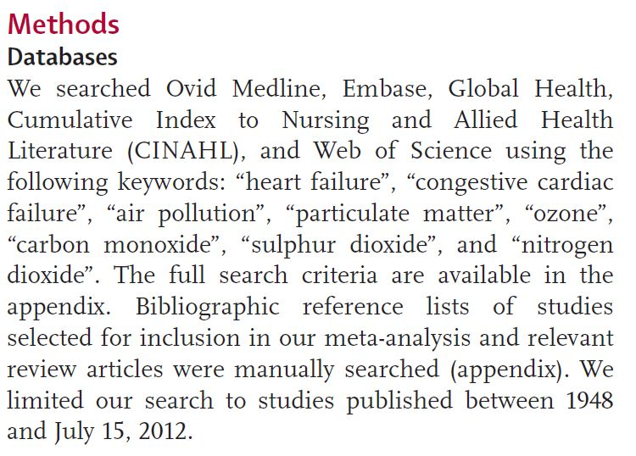
Case study 3: Air pollution and heart disease
Interpreting findings from a systematic review and meta-analysis
What database and what terms were used to find the relevant studies
Are the search terms comprehensive enough to identify studies in the area?

Slide 65
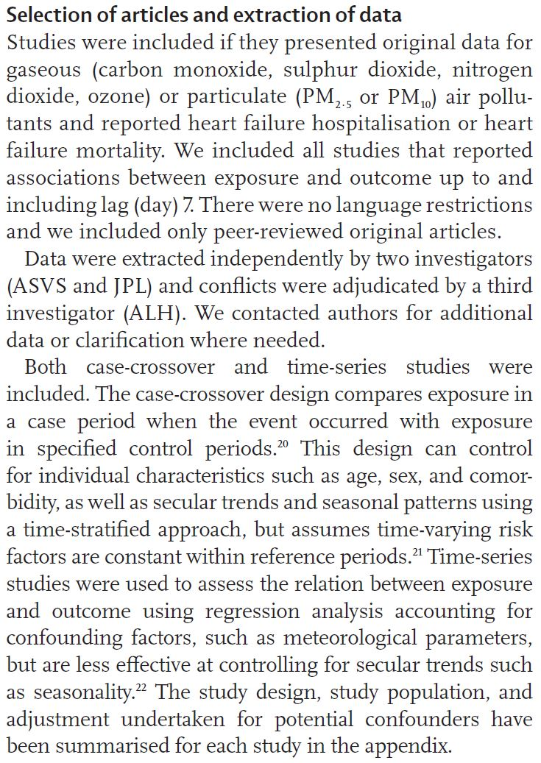
Case study 3: Air pollution and heart disease
Interpreting results from a meta-analysis
What type of studies are included?

Slide 66
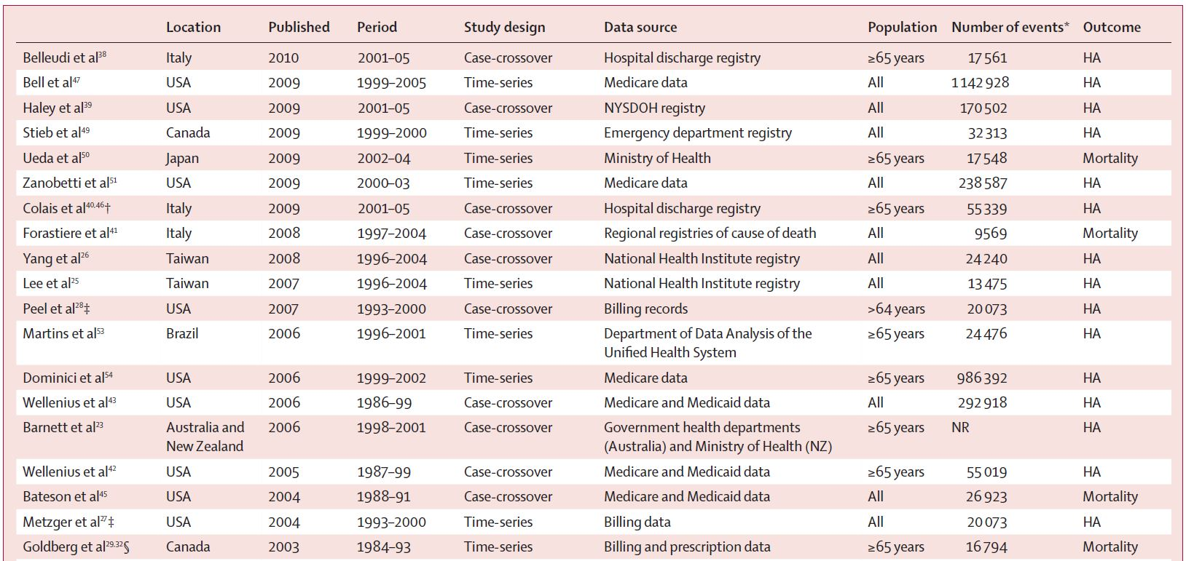
Case study 3: Air pollution and heart disease

Slide 67
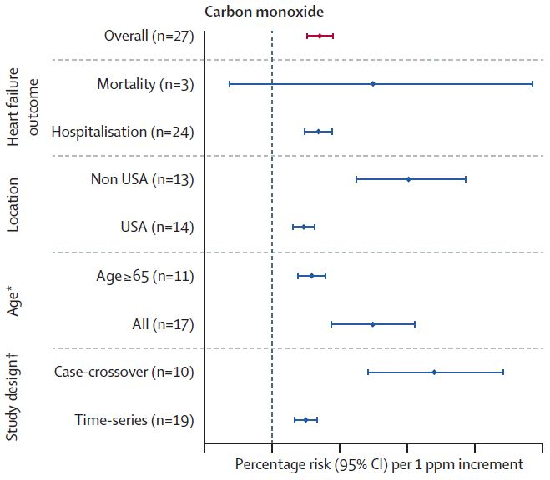
Case study 3: Air pollution and heart disease
Interpreting results from a meta-analysis
What is the combined result?

Slide 68

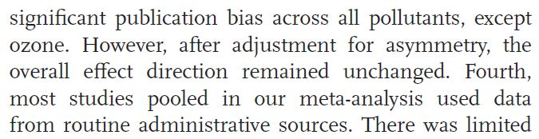
Case study 3: Air pollution and heart disease
How publication bias affect the results?
How the authors check if the results are affected by publication bias?

Slide 69
Case study 3: Air pollution and heart disease
Key points

Slide 70
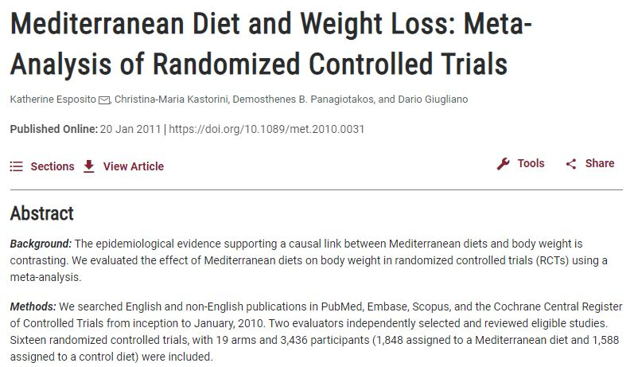
Case study 4: Mediterranean diet and BMI
Will Mediterranean diet be useful for weight management for overweight adolescents?
Existing studies mainly focused on adults.

Slide 71
Case study 4: Mediterranean diet and BMI
An intervention study can be used to examine the effect of Mediterranean diet on weight management among obese adolescents.
A well-designed intervention study can provide strong evidence on the causal effect of an exposure on an outcome.
An intervention study is an experiment
The exposure is manipulated (e.g. whether an obese adolescents receive Mediterranean diet) and the outcome (e.g. weight loss) is measured at the end of the experiment for participants receiving different level of exposure (e.g. Mediterranean diet vs vegan diet).
It is the gold standard for etiological investigation.
Randomization is the key – Participants are randomly assigned to a “treatment” condition and a “control” condition.

Slide 72
Case study 4: Mediterranean diet and BMI
Advantages of intervention study
Establish causality
Eliminate confounding by randomization
Disadvantages of intervention study
Expensive and time consuming
Ethical issues (e.g. not possible to expose participants to cigarette smoke for 20 years and see if they develop lung cancer)

Slide 73
Case study 4: Mediterranean diet and BMI
What do you want to compare with – e.g. other type of diets (low fat diet), or simple dietitian consultation
Designing a study
Clearly define the research question
“Will Mediterranean diet be useful for weight management for overweight adolescents?”
What does weight management mean? E.g. Reduction in BMI? Reduction in body fat percentage? Reduction in hip-to-waist ratio?
What does overweight adolescents mean?
E.g. Healthy individuals aged 12-18 whose BMI is between 25 and 30?

Slide 74
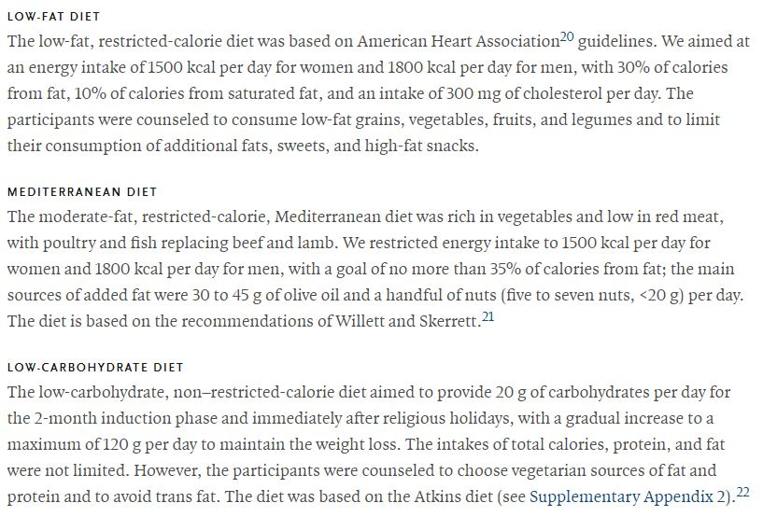
Case study 4: Mediterranean diet and BMI
Consider different study designs
Look at existing studies in the area (e.g. Shai, et al 2008)
A simple design can be a 3-arm randomized control trials with multiple follow-up
Consult an experience researcher or a statistician for more complex design

Slide 75
Case study 4: Mediterranean diet and BMI
Specify your null and alternative hypothesis.
An example can be
Null hypothesis: At the end of the trails, there will be no difference in BMI reduction between participants in the low-fat diet group and in the Mediterranean diet group.
Alternative hypothesis: At the end of the trails, participants in the Mediterranean diet group will have a larger reduction in BMI than in the low-fat diet group.

Slide 76
Case study 4: Mediterranean diet and BMI
Consider statistical power and sample size
For hypothesis testing, statistical power is the probability that the test rejects the null hypothesis when a specific alternative hypothesis is true.
Statistical power increases with sample size.
A minimum of 0.80 power should be used (i.e. 80% to reject the null hypothesis if the alternative hypothesis is true).
Sample size
Calculation required specialized software for most design (G power, R, etc)
Consult a statistician or an experienced researcher

Slide 77
Case study 4: Mediterranean diet and BMI
Statisticians will need the following information to assist with power calculation
A clearly defined research question
How the outcome variables and exposure variables are defined and measured
Design of the trials (How are the participants recruited?
The expected effect size – How big the difference you expect between the treatment group and control group?
How big the difference in BMI reduction between the low-fat diet group and Mediterranean diet group will you expect?
Look at existing literature for guidance (e.g. Meta-analysis in closely related area).
Esposito et al 2011 (a meta-analysis of Mediterranean diet on weight loss) suggests a mean BMI reduction of 0.57, with a 95% confidence interval of (0.21, 0.97).

Slide 78
Case study 4: Mediterranean diet and BMI
Key points

Slide 79

Statistical consultation
Dr. Gary Chan Centre for Youth Substance Abuse Research Faculty of Health and Behavioural Sciences University of Queensland Email: c.chan4@uq.edu.au

